Slide 1

Computer Vision Lecture 10: Edge Detection Part I
School of Software, SJTU

Slide 2
Outline
Edge Detection Fundamentals
Line Fitting

Slide 3
Edge Detection
Edge detection is the process of finding meaningful transitions in an image.
The points where sharp changes in the brightness occur typically form the border between different objects or scene parts.
Further processing of edges into lines, curves and circular arcs result in useful features for matching and recognition.
Initial stages of mammalian vision systems also involve detection of edges and local features.

Slide 4
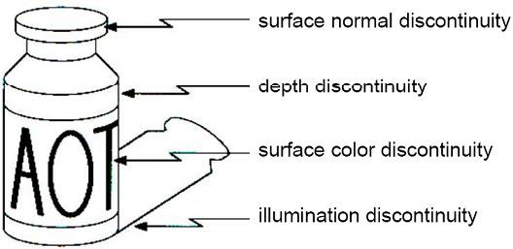
Edge Detection
Sharp changes in the image brightness occur at:
Object boundaries
A light object may lie on a dark background or a dark object may lie on a light background.
Reflectance changes
May have quite different
characteristics – zebras
have stripes, and leopards
have spots.
Cast shadows
Sharp changes in surface
orientation

Slide 5
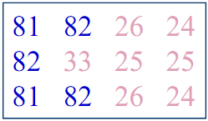
Edge Detection
Basic idea: look for a neighborhood with strong signs of change.
Problems:
Neighborhood size
How to detect change
Differential operators:
Attempt to approximate the gradient at a pixel via masks.
Threshold the gradient to select the edge pixels.

Slide 6
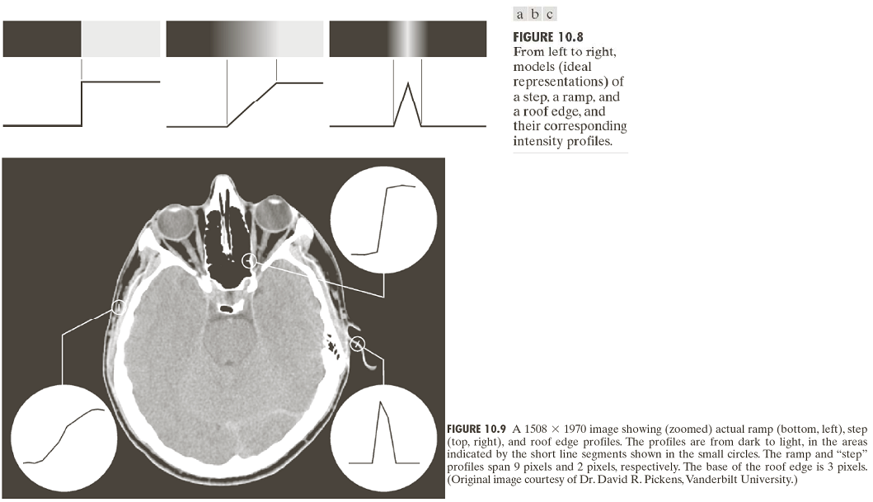
Edge Models

Slide 7
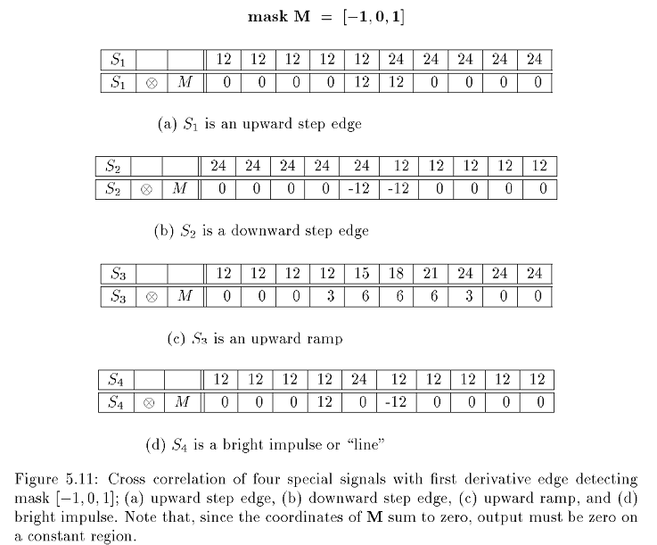
Difference Operators for 1D

Slide 8
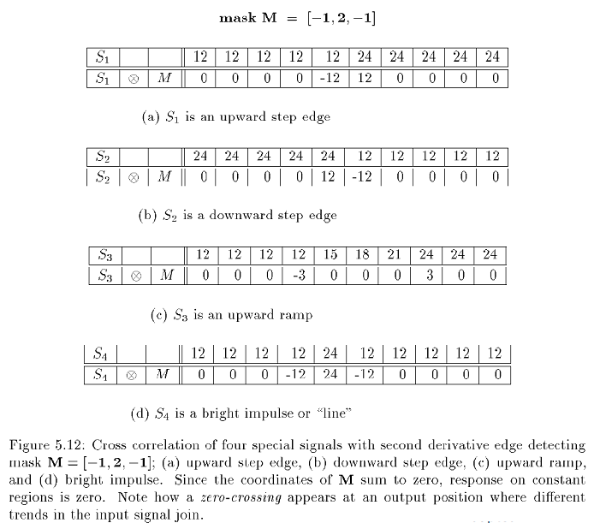
Difference Operators for 1D

Slide 9
Observations
Properties of derivative masks:
Coordinates of derivative masks have opposite signs in order to obtain a high response in signal regions of high contrast.
The sum of coordinates of derivative masks is zero so that a zero response is obtained on constant regions.
First derivative masks produce high absolute values at points of high contrast.
Second derivative masks produce zero-crossings at points of high contrast.

Slide 10
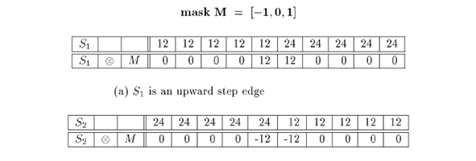
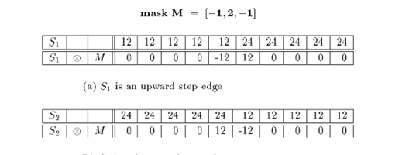
Difference Operators for 1D

Slide 11
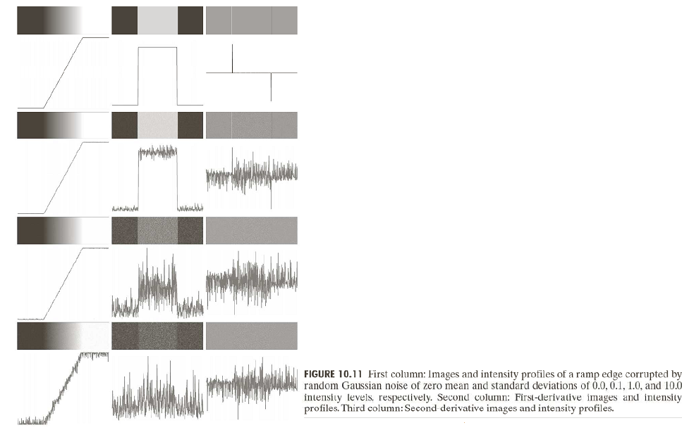
Difference Operators under Noise

Slide 12
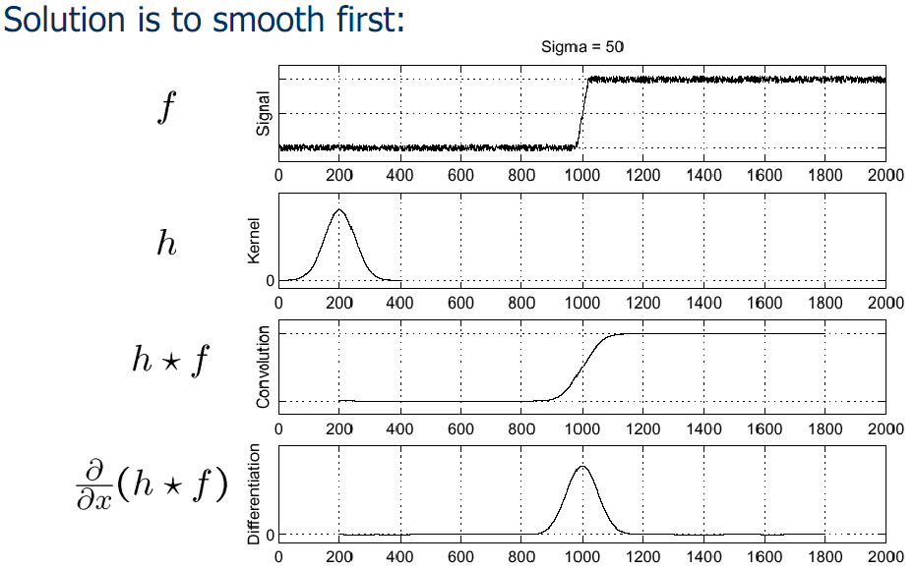
Difference Operators under Noise

Slide 13
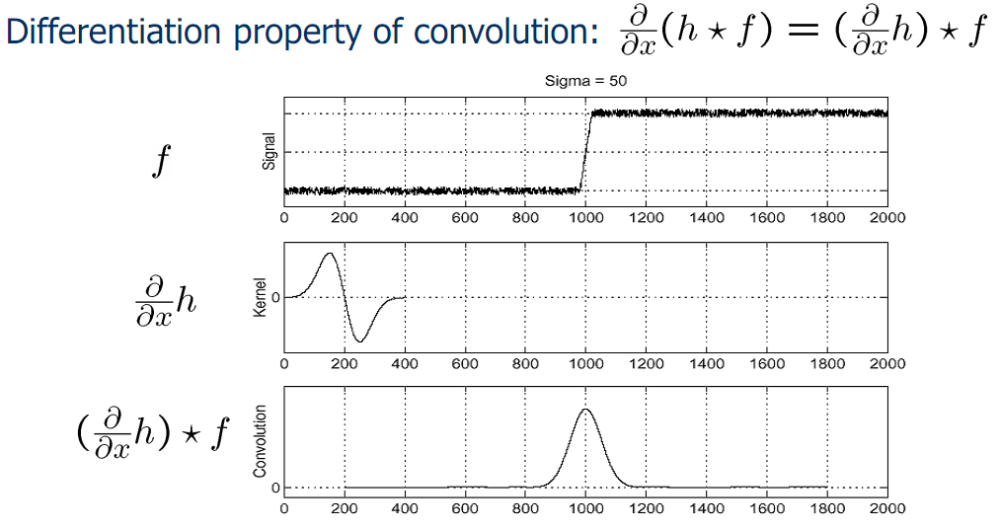
Difference Operators under Noise

Slide 14
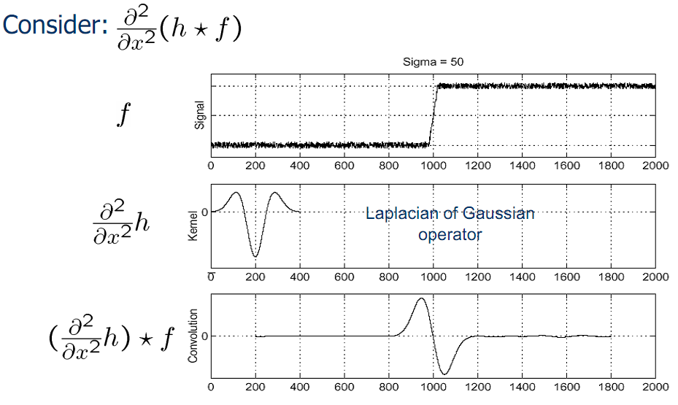
Difference Operators under Noise

Slide 15
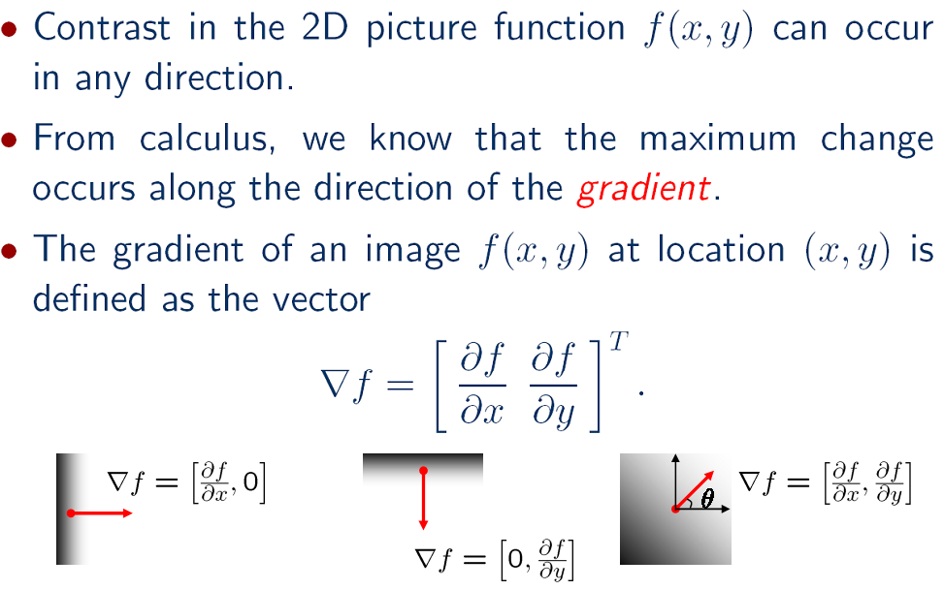
Difference Operators for 2D

Slide 16
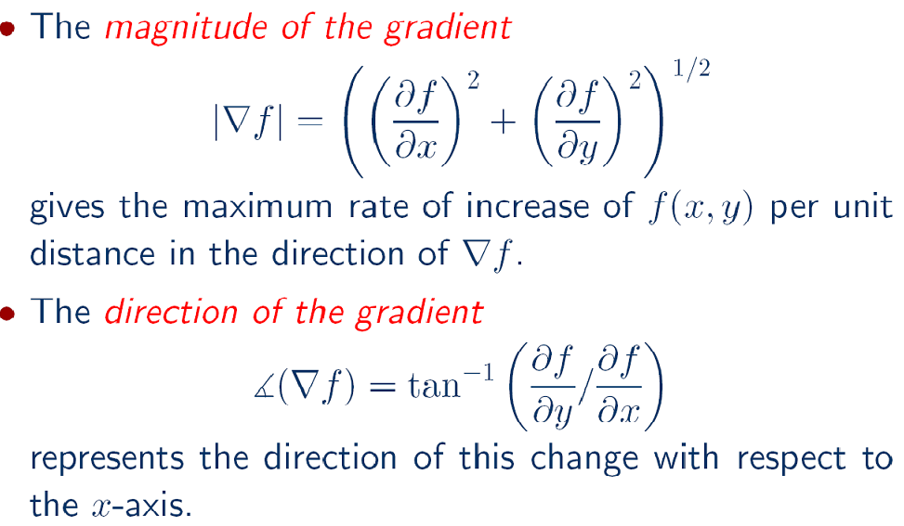
Difference Operators for 2D

Slide 17
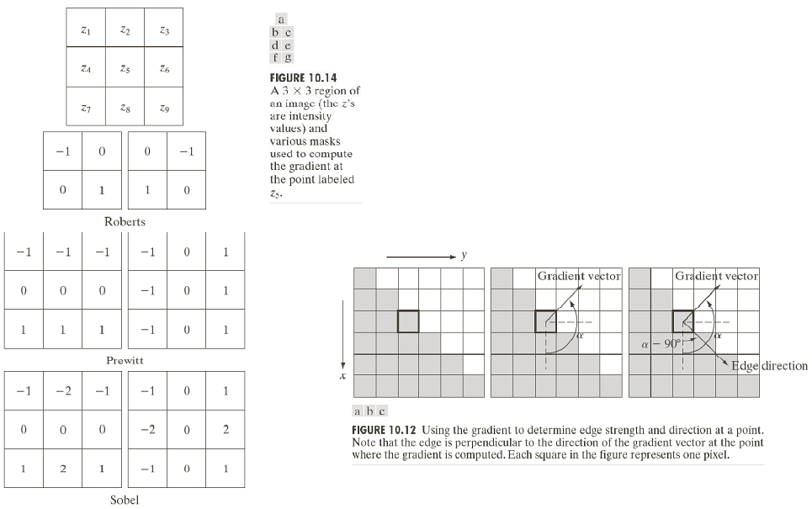
Difference Operators for 2D

Slide 18
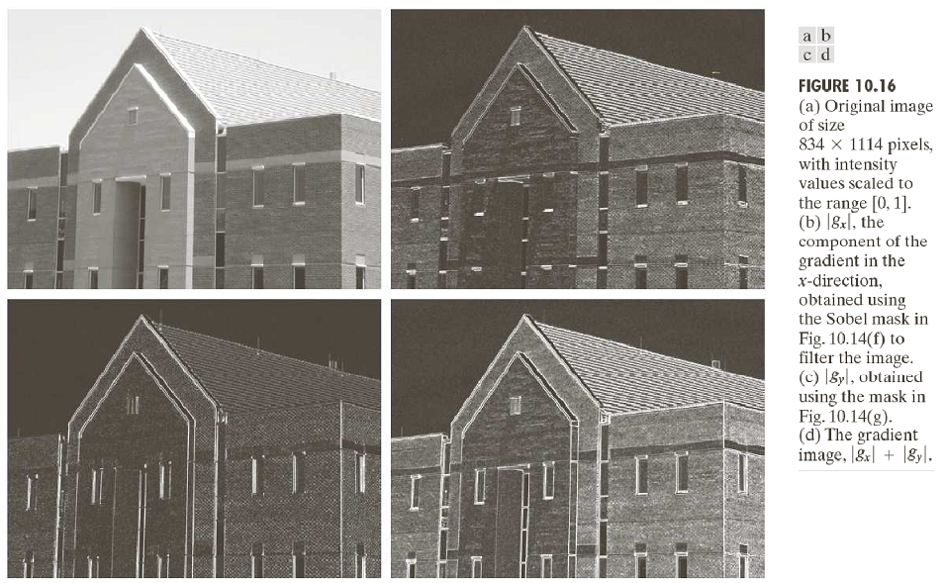
Difference Operators for 2D

Slide 19
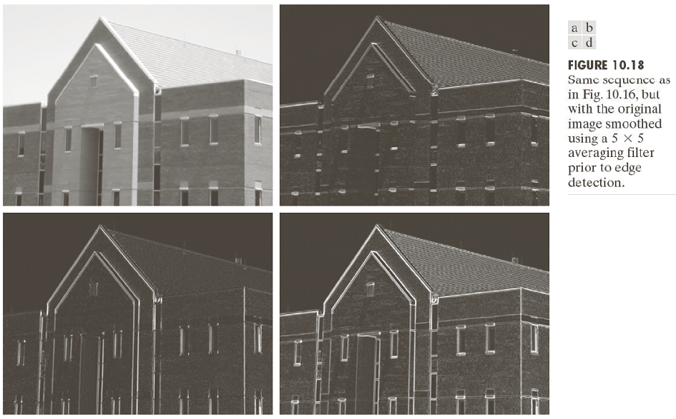
Difference Operators for 2D

Slide 20
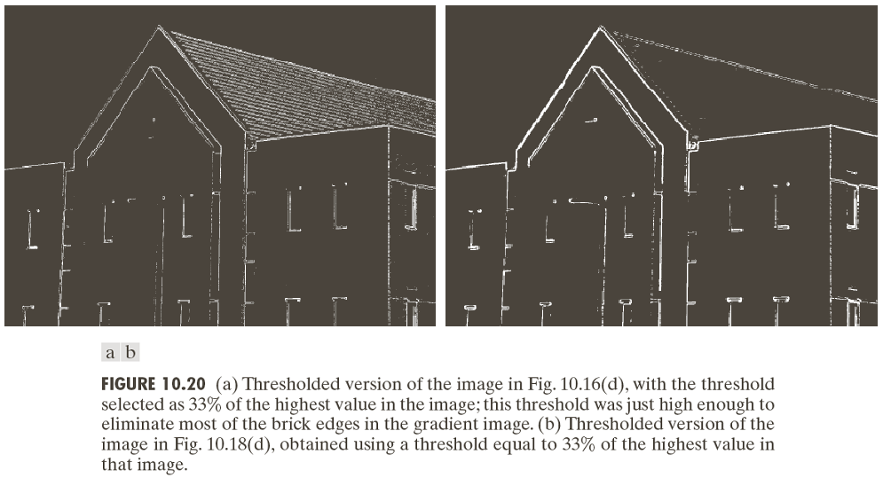
Difference Operators for 2D

Slide 21
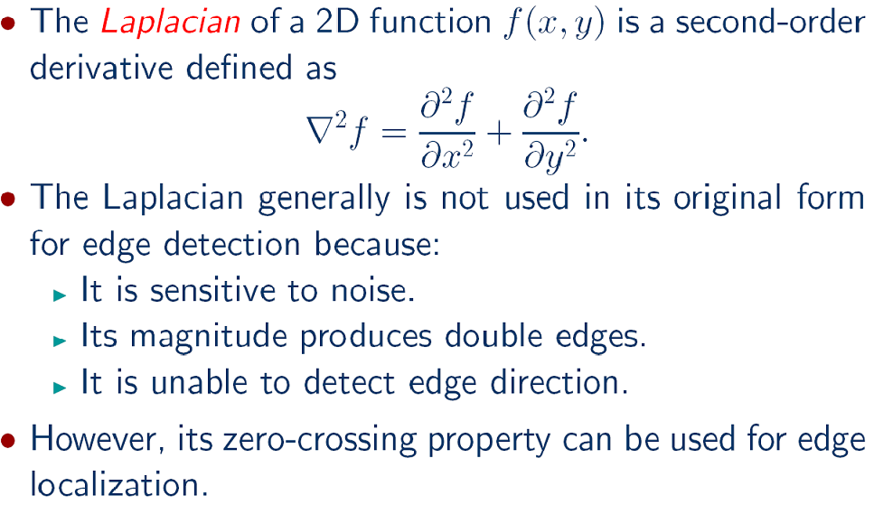
Difference Operators for 2D

Slide 22
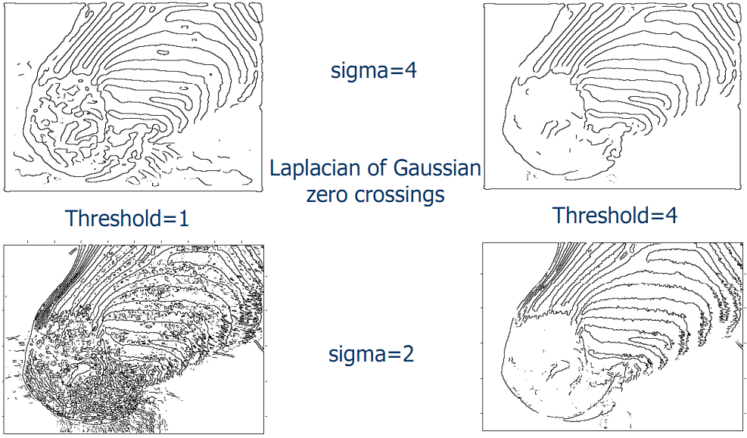
Difference Operators for 2D

Slide 23
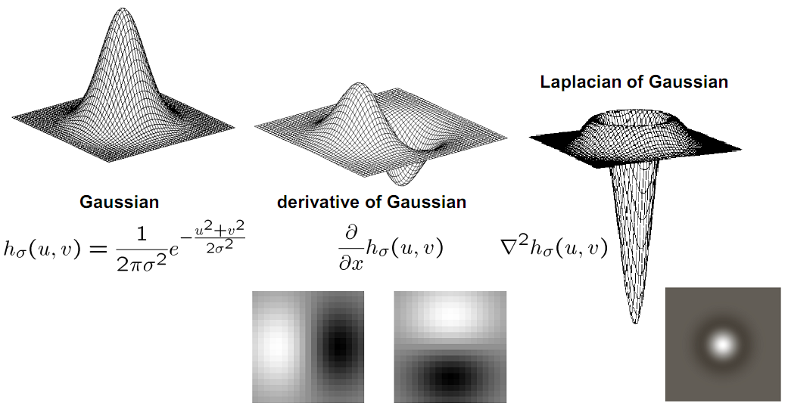
Edge Detection Filters for 2D

Slide 24
Edge Detection
Three fundamental steps in edge detection:
Image smoothing: to reduce the effects of noise.
Detection of edge points: to find all image points that are potential candidates to become edge points.
Edge localization: to select from the candidate edge points only the points that are true members of an edge.

Slide 25
Canny Edge Detector
Canny defined three objectives for edge detection:
Low error rate: All edges should be found and there should be no spurious responses.
Edge points should be well localized: The edges located must be as close as possible to the true edges.
Single edge point response: The detector should return only one point for each true edge point. That is, the number of local maxima around the true edge should be minimum.

Slide 26
Canny Edge Detector
Smooth the image with a Gaussian filter with spread σ.
Compute gradient magnitude and direction at each pixel of the smoothed image.
Zero out any pixel response less than or equal to the two neighboring pixels on either side of it, along the direction of the gradient (non-maxima suppression).
Track high-magnitude contours using thresholding.
Keep only pixels along these contours, so weak little segments go away.

Slide 27
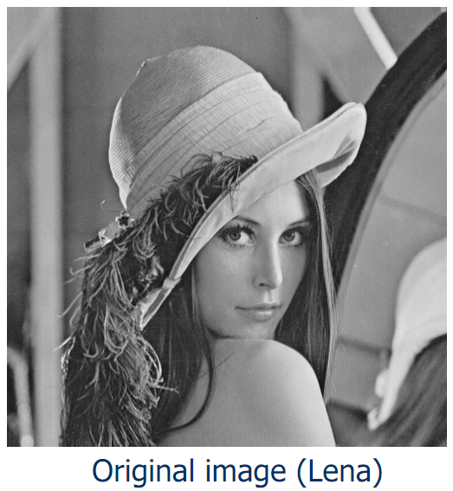
Canny Edge Detector

Slide 28
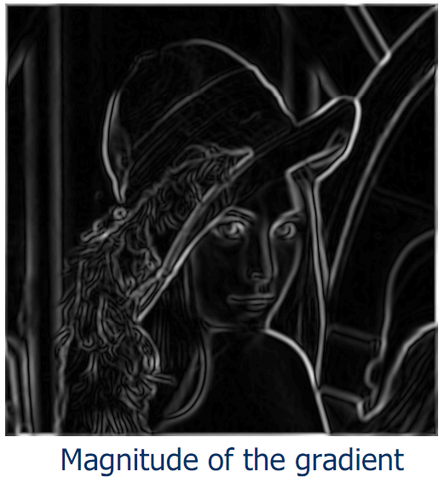
Canny Edge Detector

Slide 29
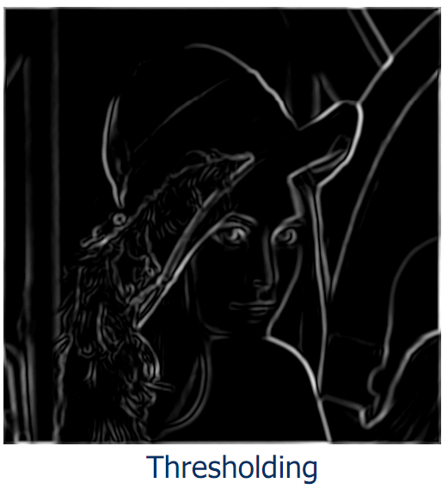
Canny Edge Detector

Slide 30
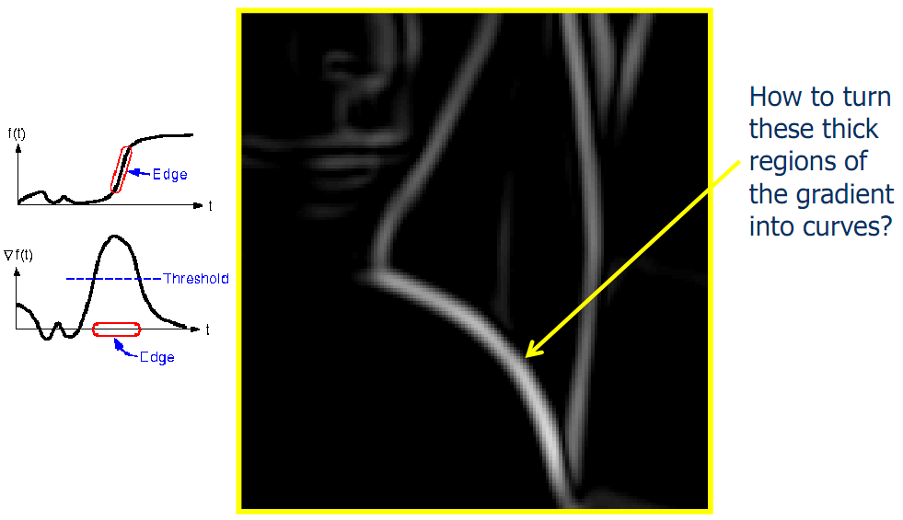
Canny Edge Detector

Slide 31
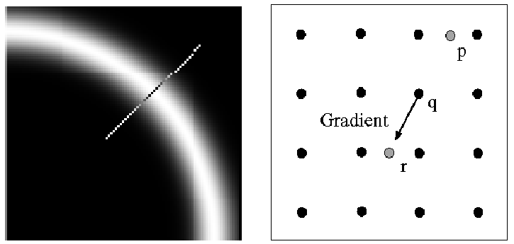
Canny Edge Detector
Non-maxima suppression:
Check if pixel is local maximum along gradient direction.
Select single max across width of the edge.
Requires checking interpolated pixels p and r.
This operation can be used with any edge operator when thin boundaries are wanted.

Slide 32
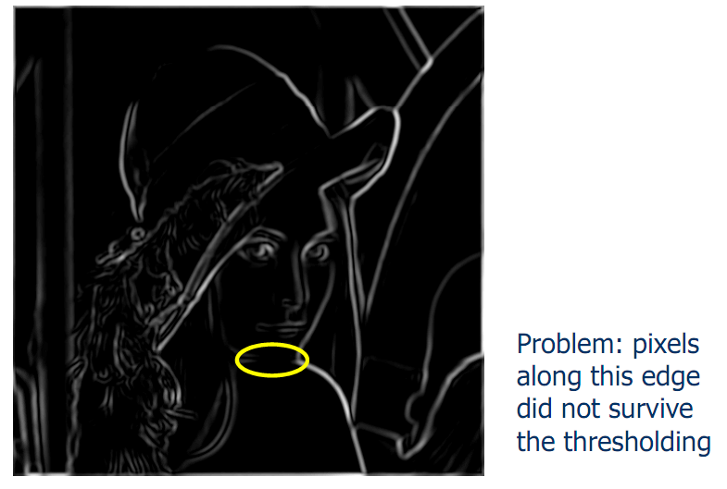
Canny Edge Detector

Slide 33
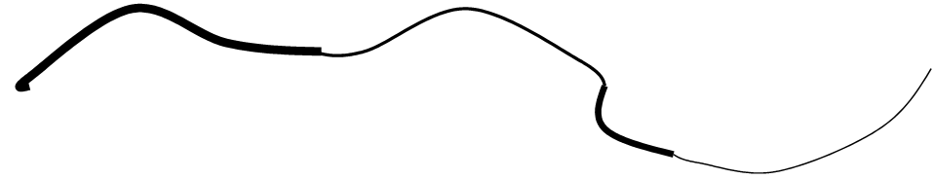
Canny Edge Detector
Hysteresis thresholding:
Use a high threshold to start edge curves, and a low threshold to continue them.

Slide 34
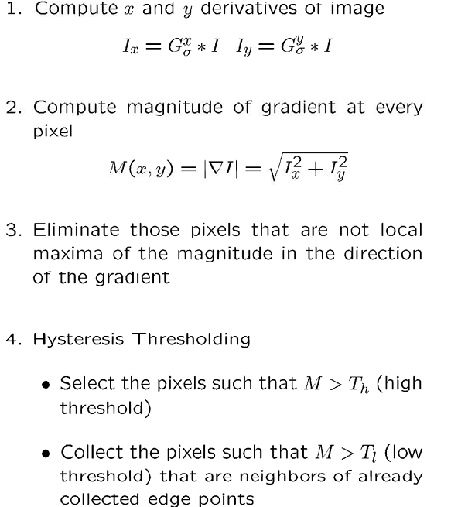
Canny Edge Detector

Slide 35
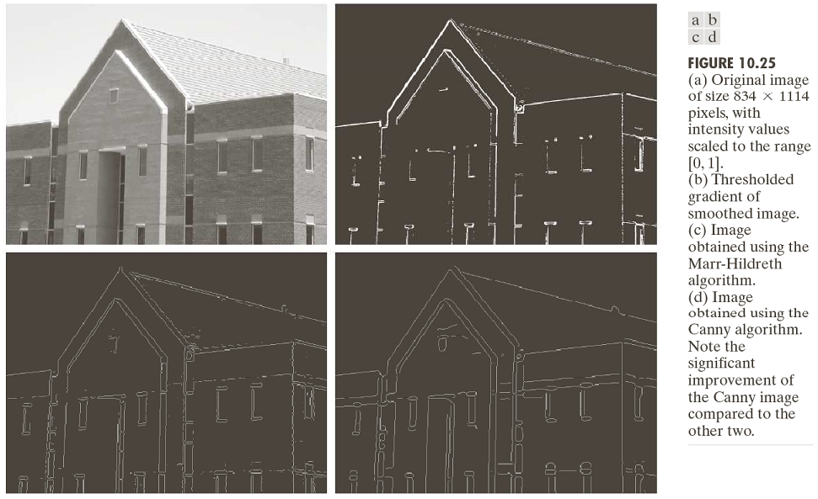
Canny Edge Detector

Slide 36
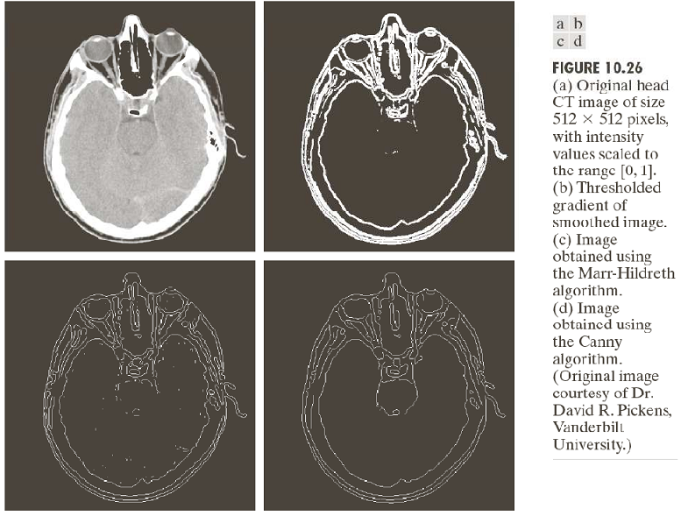
Canny Edge Detector

Slide 37
Canny Edge Detector
The Canny operator gives single-pixel-wide images with good continuation between adjacent pixels.
It is the most widely used edge operator today; no one has done better since it came out in the late 80s. Many implementations are available.
It is very sensitive to its parameters, which need to be adjusted for different application domains.

Slide 38
Edge Linking
Hough transform
Finding line segments
Finding circles
Model fitting
Fitting line segments
Fitting ellipses
Edge tracking

Slide 39
Fitting: Main Idea
Choose a parametric model to represent a set of features
Membership criterion is not local
Cannot tell whether a point belongs to a given model just by looking at that point
Three main questions:
What model represents this set of features best?
Which of several model instances gets which feature?
How many model instances are there?
Computational complexity is important
It is infeasible to examine every possible set of parameters and every possible combination of features

Slide 40
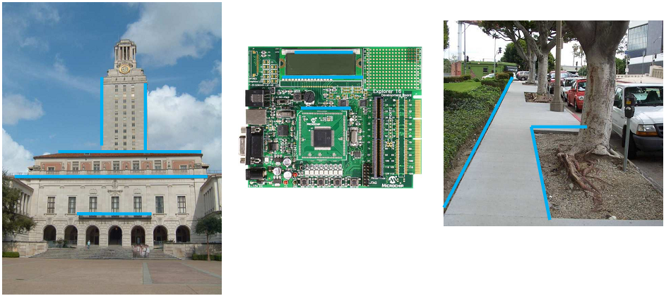
Example: Line Fitting
Why fit lines?
Many objects characterized by presence of straight lines

Slide 41
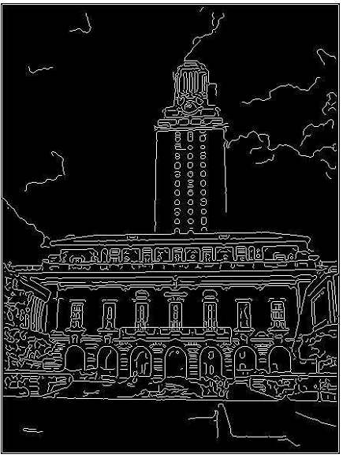
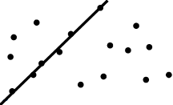
Difficulty of Line Fitting
Extra edge points (clutter), multiple models:
which points go with which line, if any?
Only some parts of each line detected, and some parts are missing:
how to find a line that bridges missing evidence?
Noise in measured edge points, orientations:
how to detect true underlying parameters?

Slide 42
Voting
It is not feasible to check all combinations of features by fitting a model to each possible subset.
Voting is a general technique where we let each feature vote for all models that are compatible with it.
Cycle through features, cast votes for model parameters.
Look for model parameters that receive a lot of votes.
Noise and clutter features will cast votes too, but typically their votes should be inconsistent with the majority of “good” features.

Slide 43
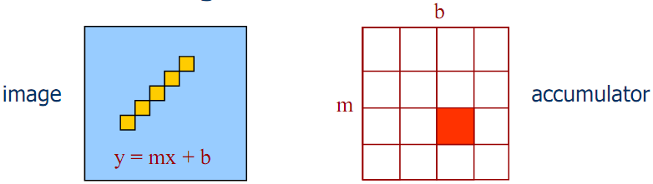
Hough Transform
The Hough transform is a method for detecting lines or curves specified by a parametric function.
If the parameters are p₁, p₂, … p_{n}, then the Hough procedure uses an n-dimensional accumulator array in which it accumulates votes for the correct parameters of the lines or curves found on the image.

Slide 44
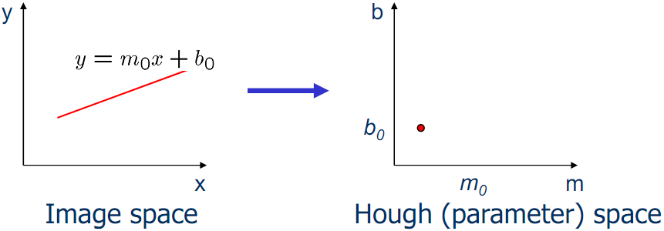
Hough Transform: Line Segments
Connection between image (x,y) and Hough (m,b) spaces
A line in the image corresponds to a point in Hough space
To go from image space to Hough space:
given a set of points (x,y), find all (m,b) such that y = mx + b

Slide 45
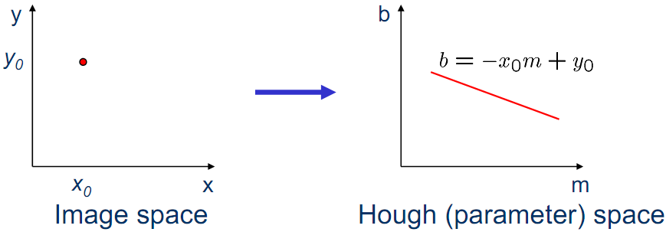
Hough Transform: Line Segments
Connection between image (x,y) and Hough (m,b) spaces
What does a point (x , y ) in the image space map to?
Answer: the solutions of b = -x₀m + y₀
This is a line in Hough space

Slide 46
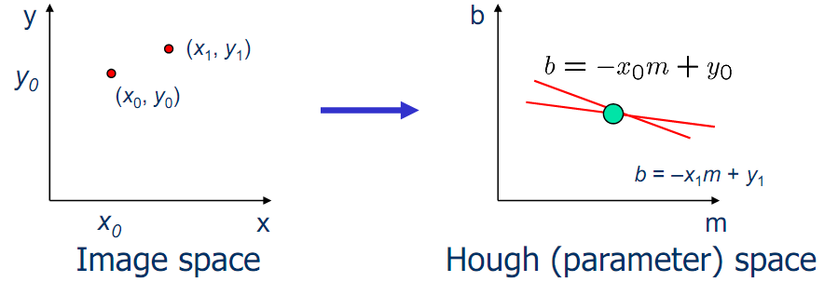
Hough Transform: Line Segments
What are the line parameters for the line that contains both (x₀, y₀) and (x₁, y₁)?
It is the intersection of the lines b = –x₀m + y₀ and b = –x₁m + y₁

Slide 47
HOUGH TRANSFORM
In 1967, Hough proposed to detect line in parameter space, called Hough transform (HT) technique
B
y
b
b=-x_{n}a+y_{n}
(x₁,y₁)
*
(x₂,y₂)
*
y=Ax+B
A
+
b=-x₂a+y₂
(x_{n},y_{n})
Cluster
b=-x₁a+y₁
*
x
Image space
a
Parameter space

Slide 48
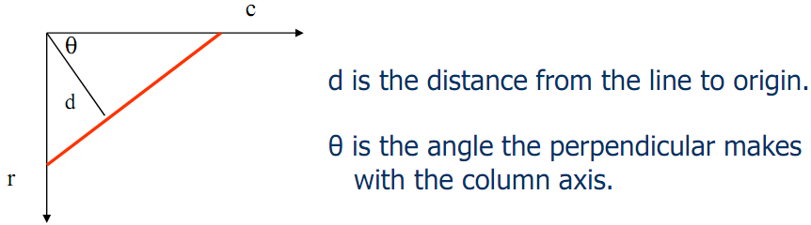
Hough Transform: Line Segments
y = mx + b is not suitable (why?)
The equation generally used is:
d = r sin(θ) + c cos(θ).

Slide 49
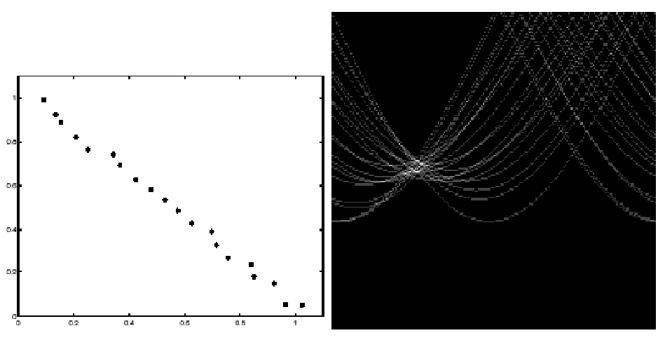
Hough Transform: Line Segments

Slide 50
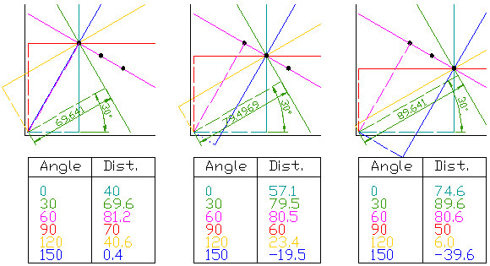
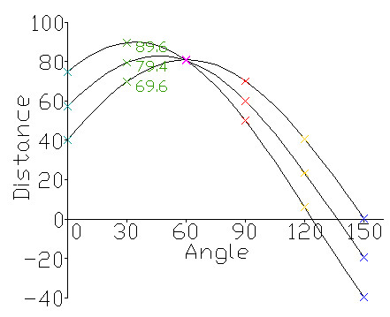
Hough Transform: Line Segments

Slide 51
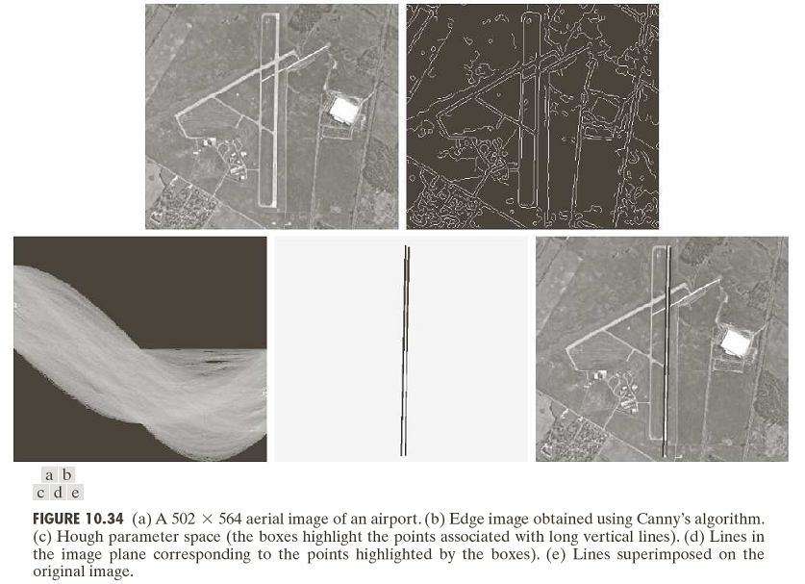
Hough Transform: Line Segments

Slide 52
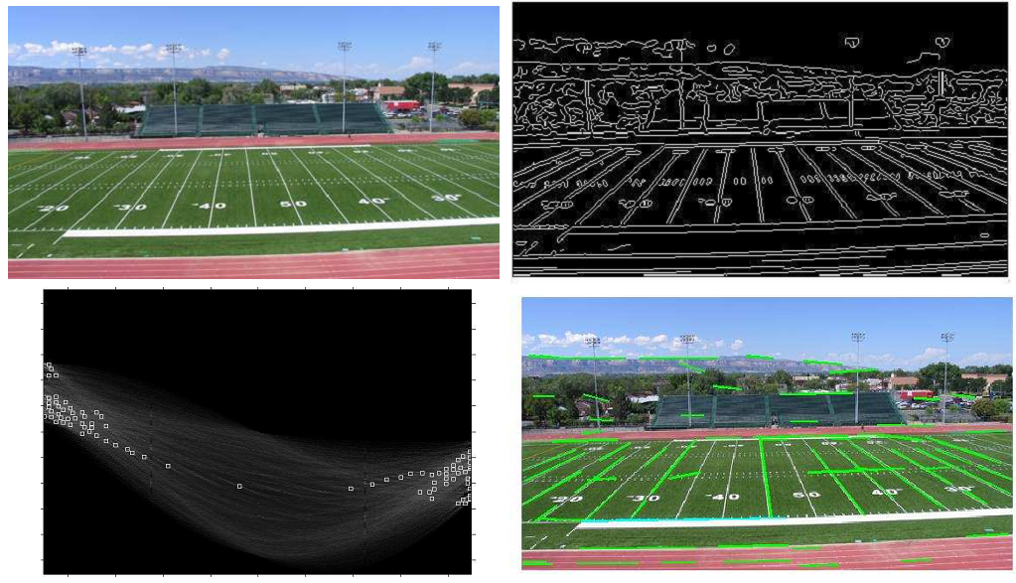
Hough Transform: Line Segments

Slide 53
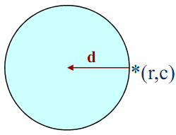
Hough Transform: Circles
Main idea: The gradient vector at an edge pixel points the center of the circle.
Circle equations:
r = r₀ + d sin(θ) r₀, c₀, d are parameters
c = c₀ + d cos(θ)

Slide 54
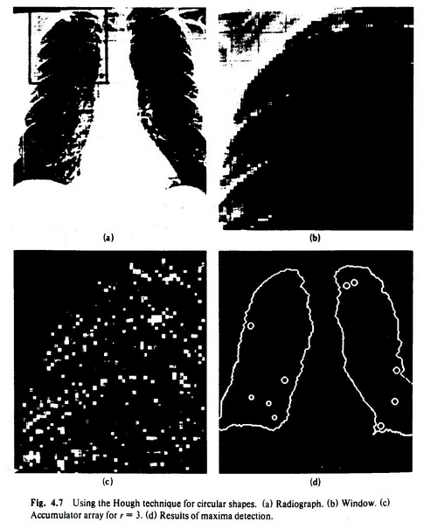
Hough Transform: Circles

Slide 55
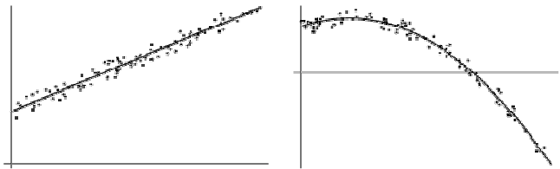
Model Fitting
Mathematical models that fit data not only reveal important structure in the data, but also can provide efficient representations for further analysis.
Mathematical models exist for lines, circles, cylinders, and many other shapes.
We can use the method of least squares for determining the parameters of the best mathematical model fitting the observed data.

Slide 56
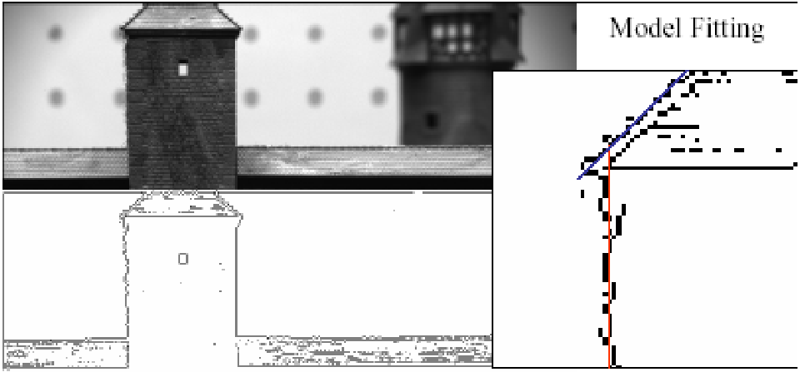
Model Fitting: Line Segments

Slide 57
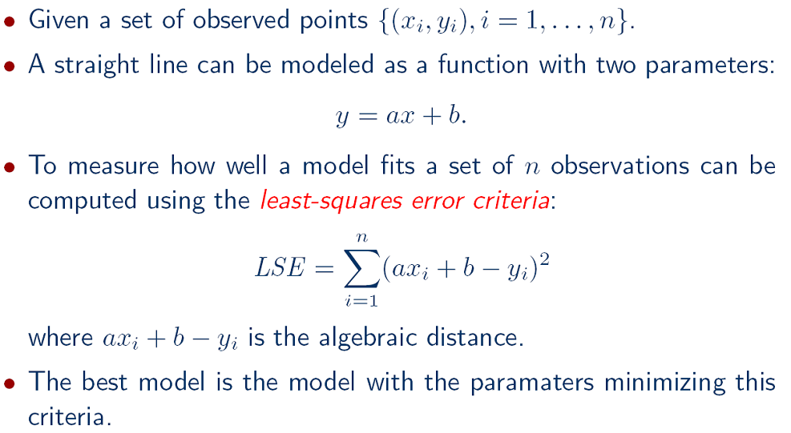
Model Fitting: Line Segments

Slide 58
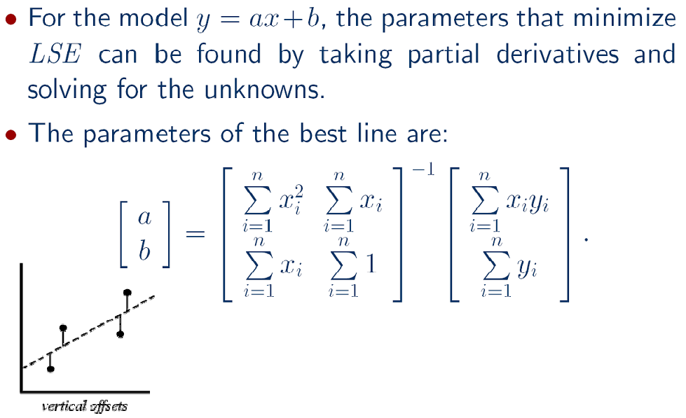
Model Fitting: Line Segments

Slide 59
Model Fitting: Line Segments
Problems in fitting:
Outliers
Error definition (algebraic vs. geometric distance)
Statistical interpretation of the error (hypothesis testing)
Nonlinear optimization
High dimensionality (of the data and/or the number of model parameters)
Additional fit constraints

Slide 60
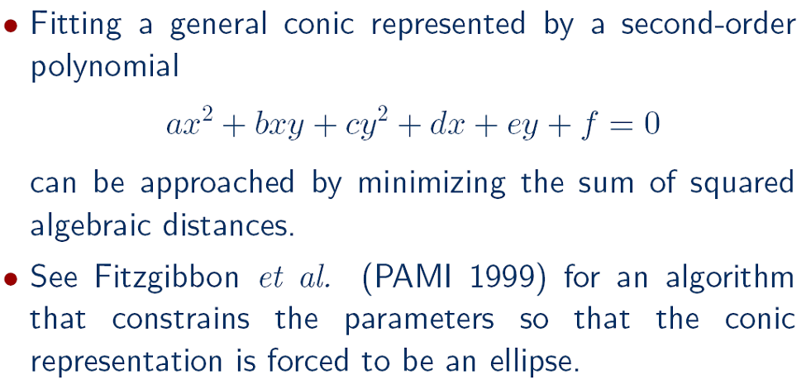
Model Fitting: Ellipses

Slide 61

Model Fitting: Incremental Line Fitting

Slide 62

Model Fitting: Incremental Line Fitting

Slide 63

Model Fitting: Incremental Line Fitting

Slide 64

Model Fitting: Incremental Line Fitting

Slide 65

Model Fitting: Incremental Line Fitting

Slide 66

Model Fitting: Incremental Line Fitting

Slide 67

Edge Tracking
Mask-based approach uses masks to identify the following events:
start of a new segment,
interior point continuing a segment,
end of a segment,
junction between multiple segments,
corner that breaks a segment into two.

Slide 68
Edge Tracking: ORT Toolkit
Designed by Ata Etemadi.
The algorithm is called Strider and is like a spider moving along pixel chains of an image, looking for junctions and corners.
It identifies them by a measure of local asymmetry.
When it is moving along a straight or curved segment with no interruptions, its legs are symmetric about its body.
When it encounters an obstacle (i.e., a corner or junction) its legs are no longer symmetric.
If the obstacle is small (compared to the spider), it soon becomes symmetrical.
The accuracy depends on the length of the spider and the size of its stride.
The larger they are, the less sensitive it becomes.

Slide 69

Edge Tracking: ORT Toolkit

Slide 70
Edge Tracking: ORT Toolkit
The parameters are the length of the spider and the number of pixels per step.
These parameters can be changed to allow for less sensitivity, so that we get longer line segments.
The algorithm has a final phase in which adjacent segments whose angle differs by less than a given threshold are joined.
Advantages:
Works on pixel chains of arbitrary complexity.
Can be implemented in parallel.
No assumptions and parameters are well understood.

